Slide 1
Shitty bird
With: Dan Scott, Jatan Buch & Atsushi Kikumoto

Slide 2
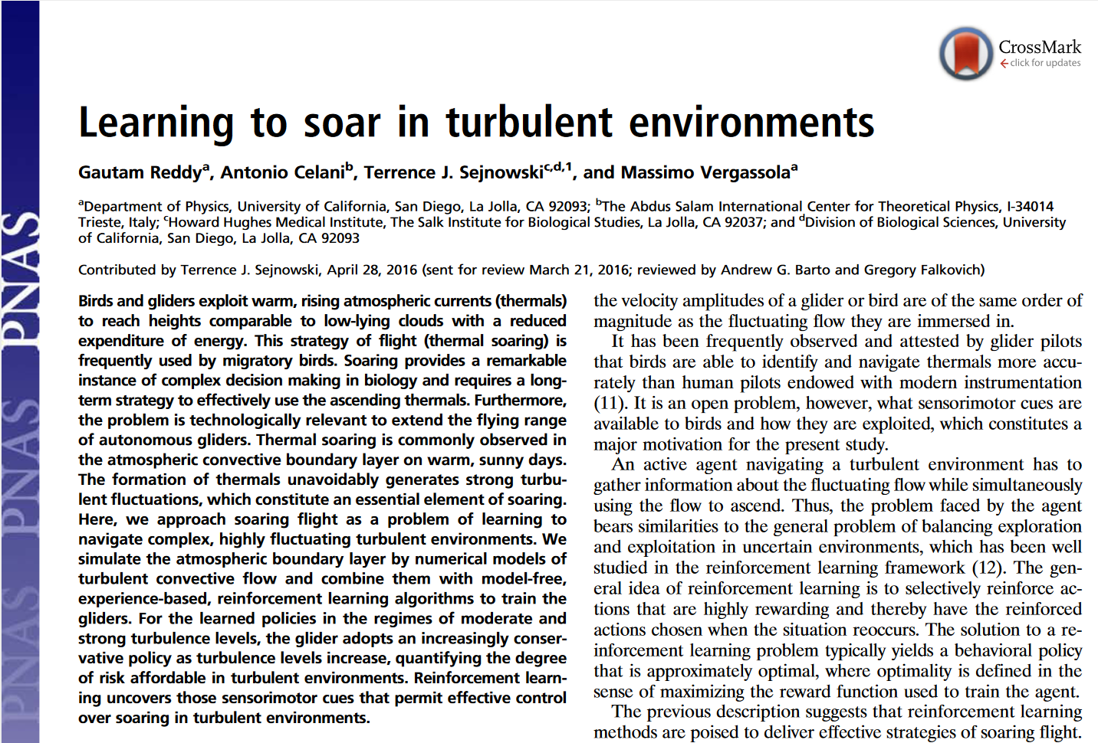
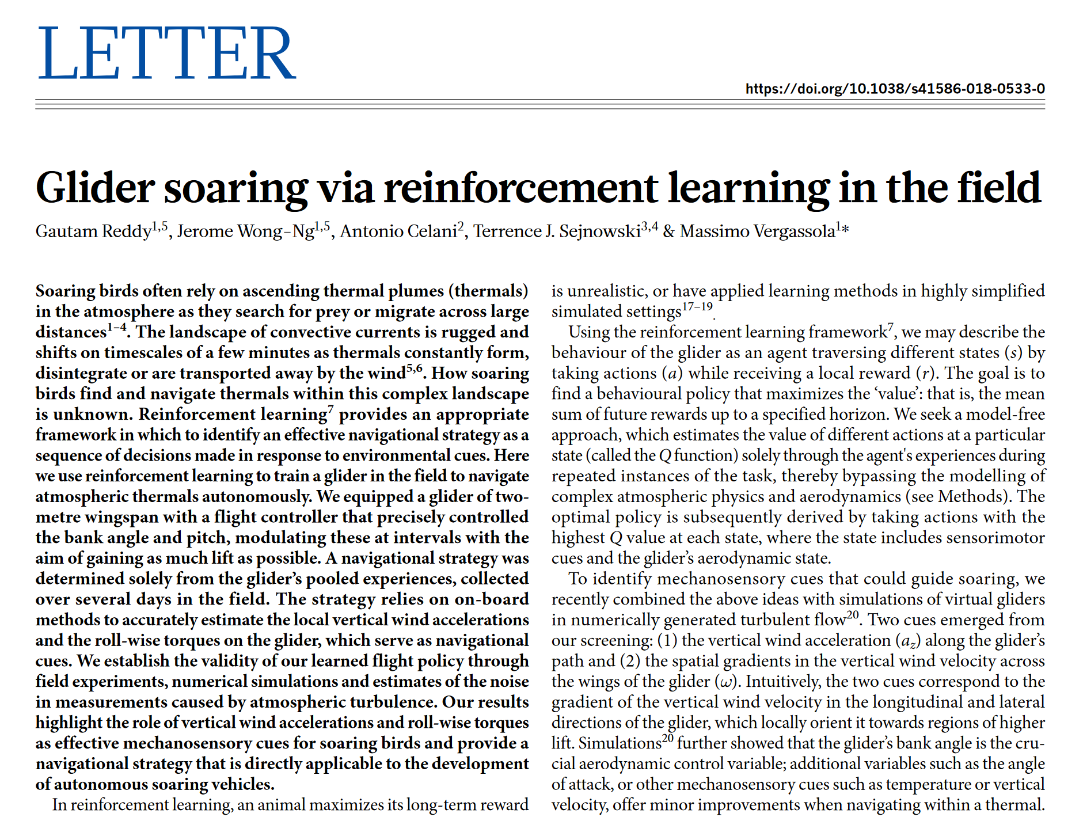
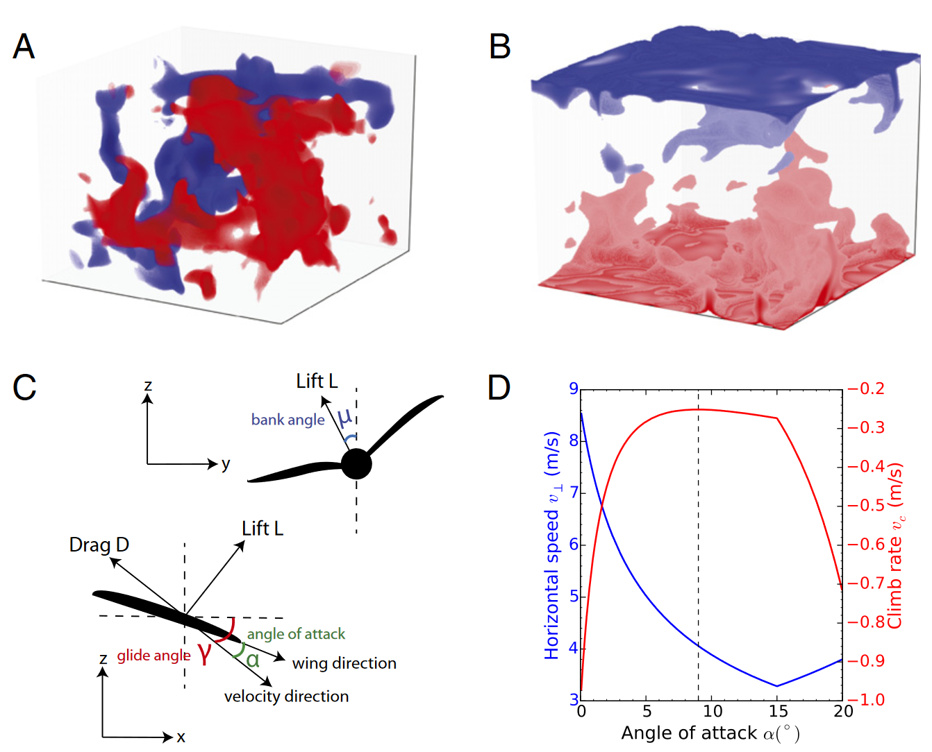
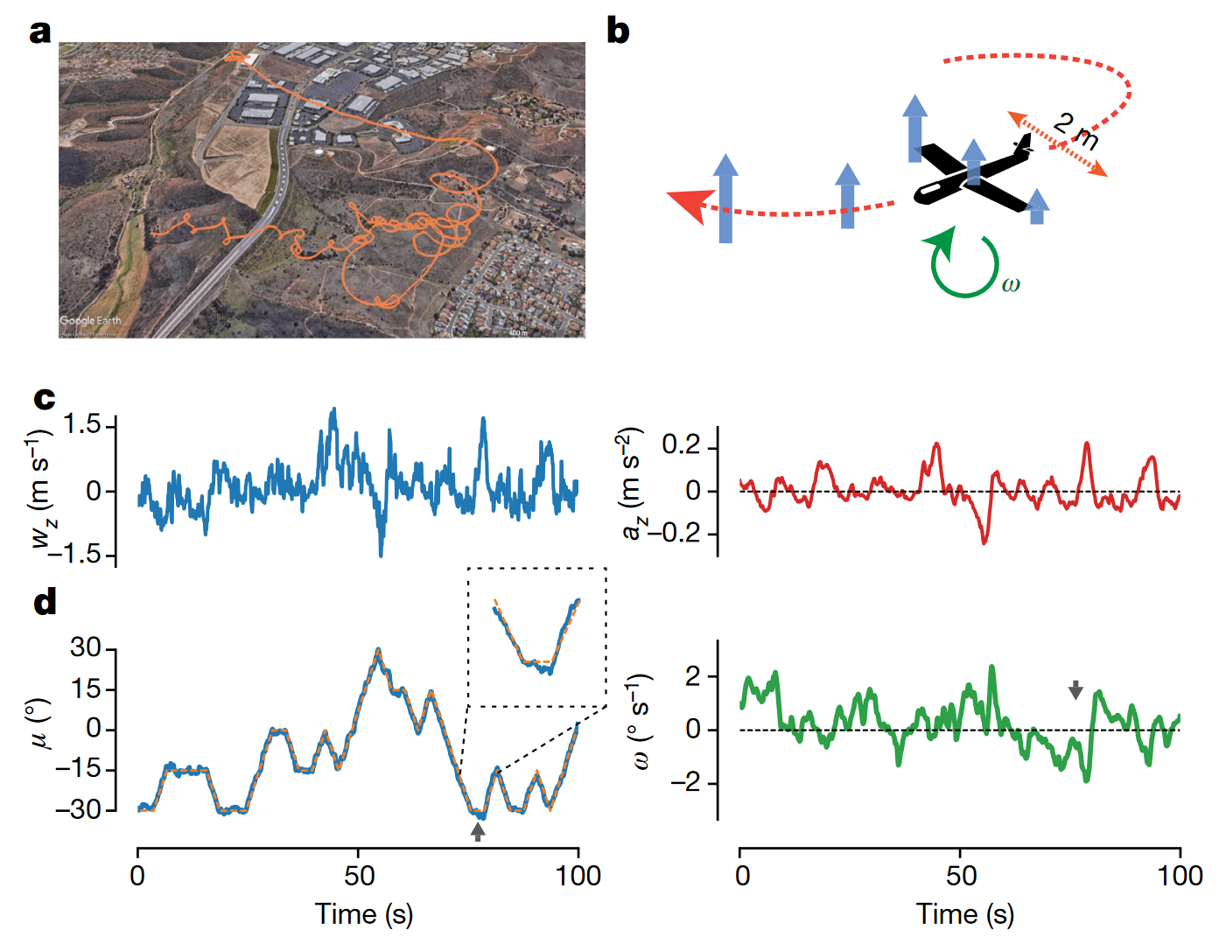
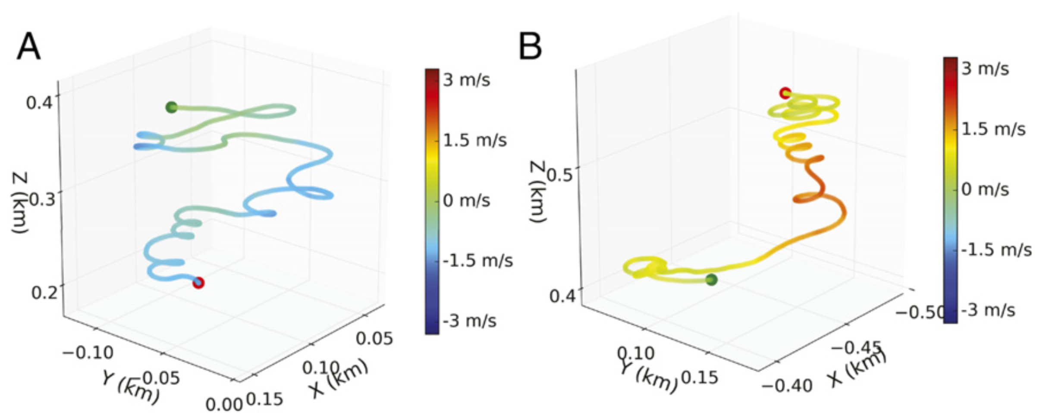
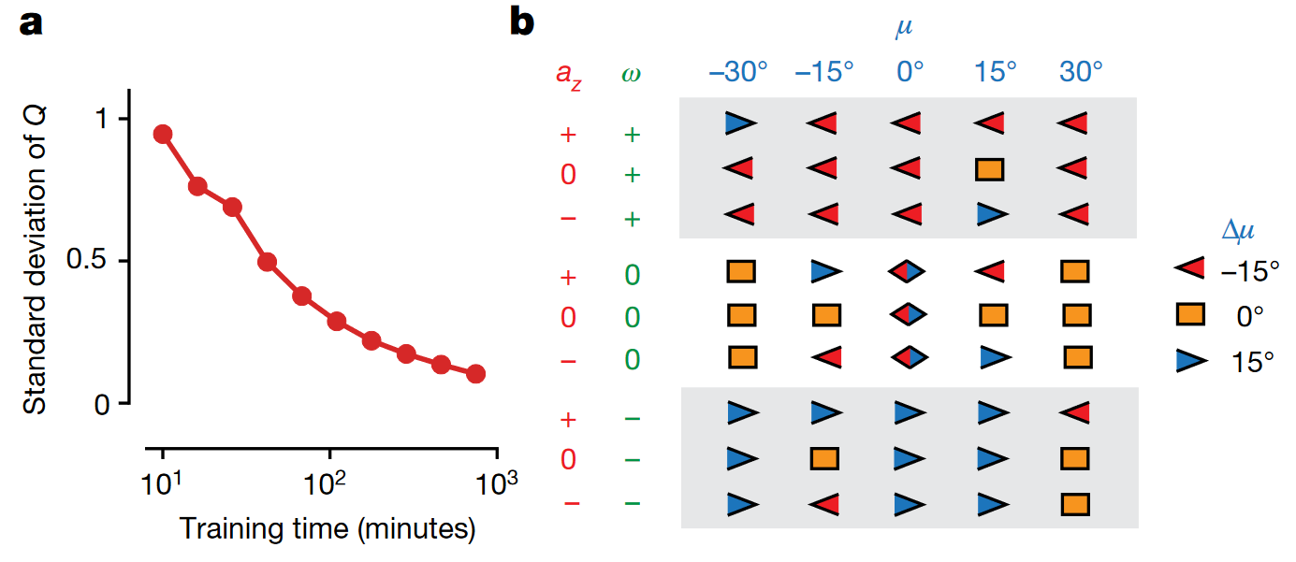

Slide 3
Shitty bird
Can a bird with a bad model soar better than the SARSA (model-free) bird?
First try out some of these ideas in the Cartpole setup

Slide 4
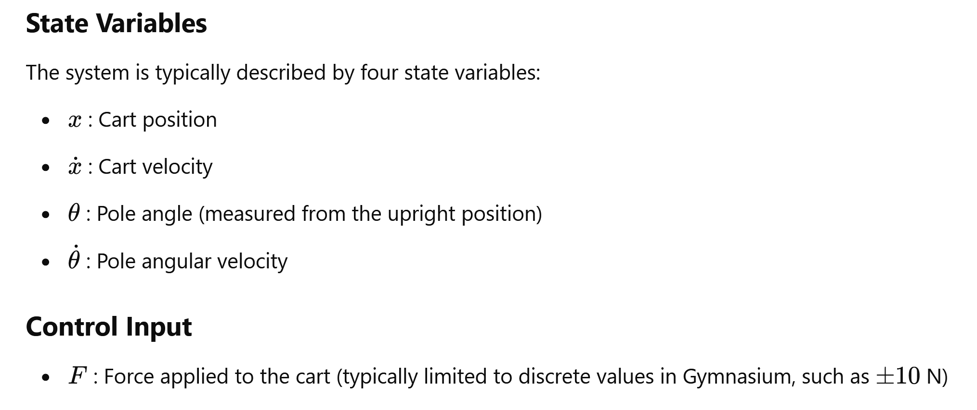
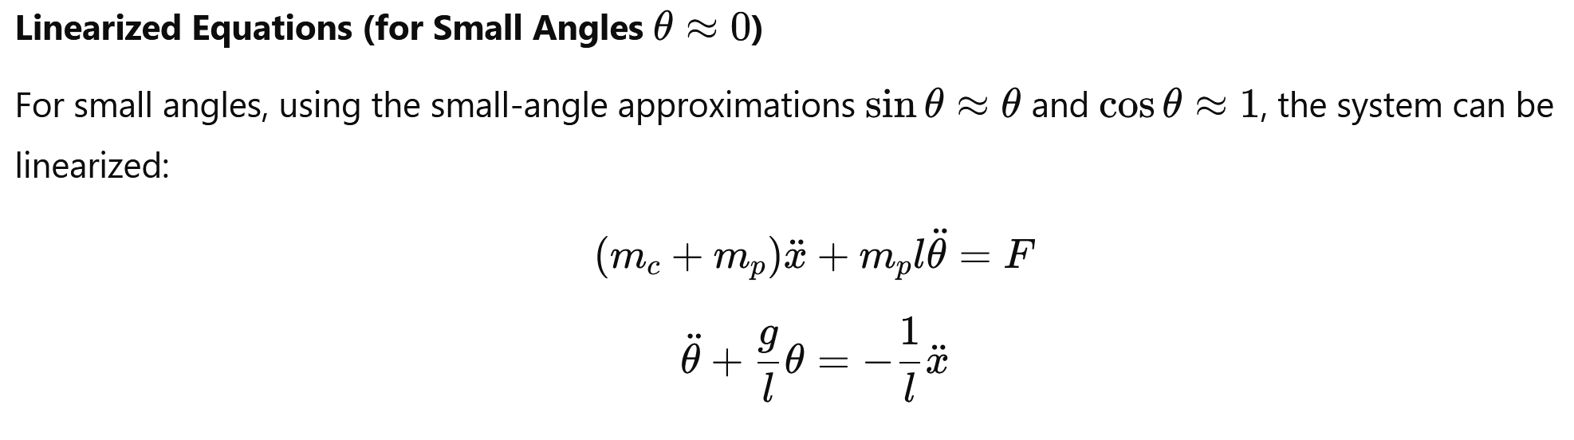
Cartpole

Slide 5
Control setup
Train model-free RL models (Q-learning & policy gradient)
DQN
PPO
Have the MPC agent solve this
Varying horizon lengths (10 vs. 50) and recompute frequencies (1 vs. 5)
Add noise
Check how long you can balance it – max 500 timesteps

Slide 6
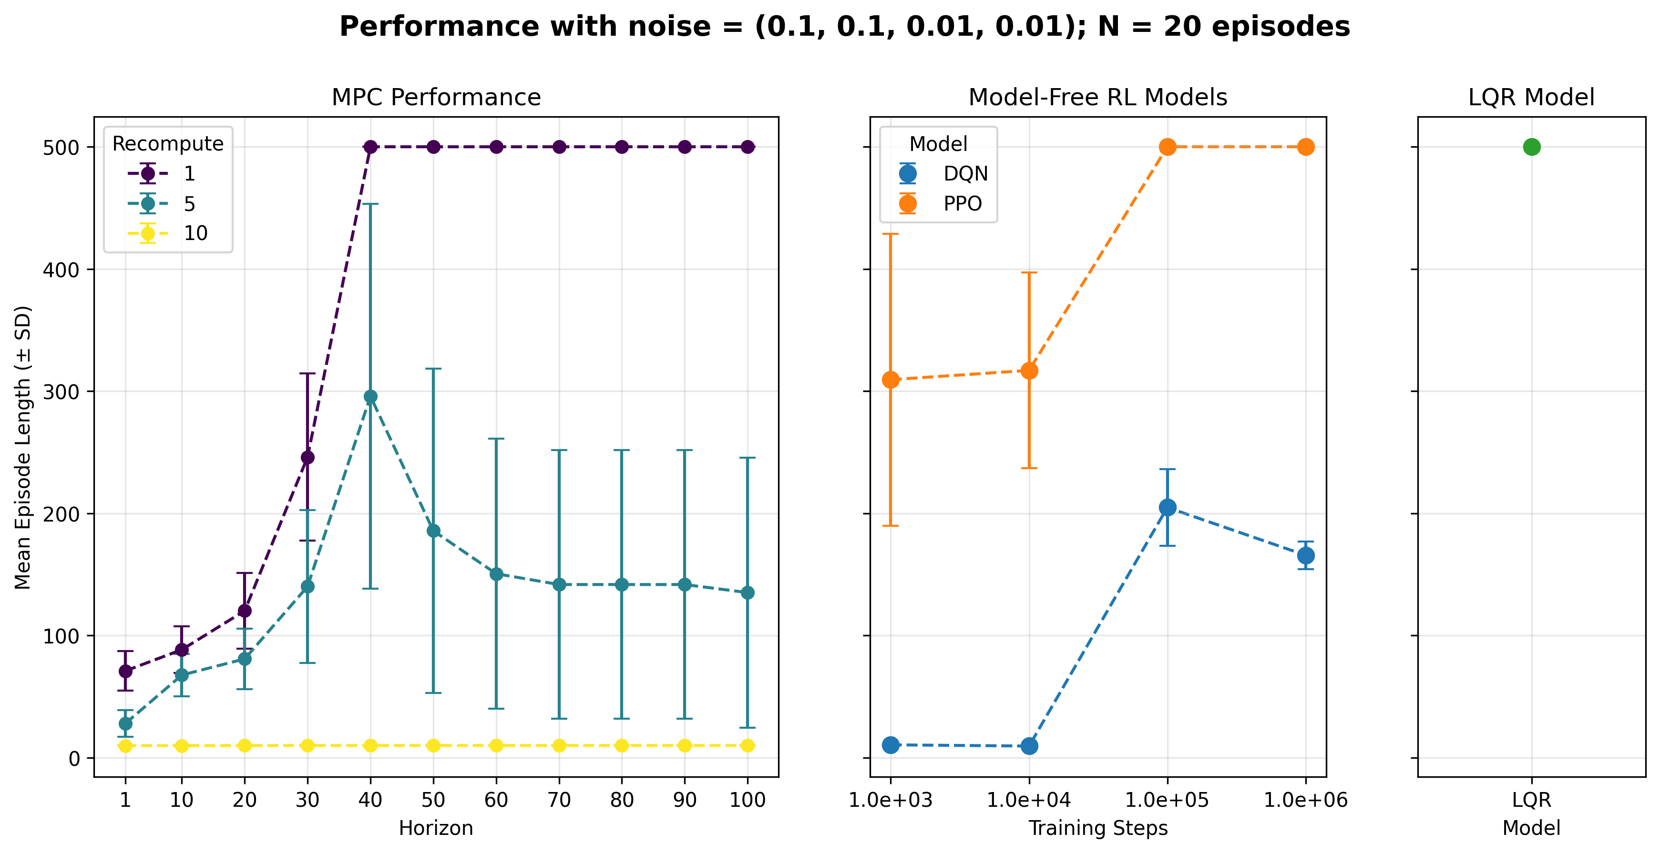
Results – low noise (non-linear dynamics MPC)

Slide 7
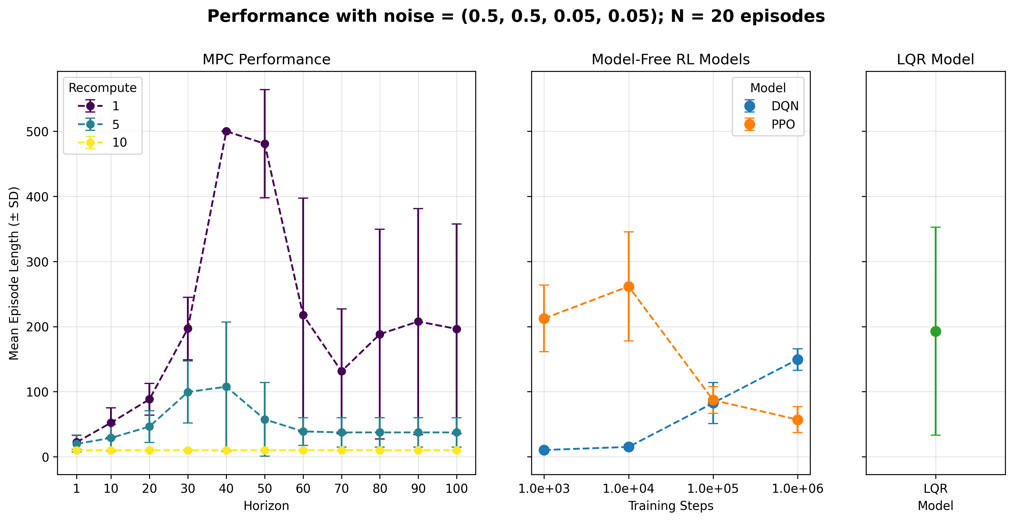
Results – high noise (non-linear dynamics MPC)

